Slide 1

Online Voting System
GROUP NUMBER- 68

Slide 2
ELECTORAL SYSTEM OF INDIA
The Election Commission of India is an autonomous constitutional authority responsible for administering Union and State election processes in India.
The body administers elections to the Lok Sabha, Rajya Sabha, State Legislative Assemblies in India, and the offices of the President and Vice President in the country.
India, being a Union of states, has separate state legislatures for each state. State legislatures consist of the Governor and two Houses — Legislative Council and Legislative Assembly

Slide 3
THE DEMOGRAPHICS
Total Population | 1.2 billion
Total Area | 3.3 million km2
Number of Electors | 834,082,814 (compared to 173,212,343 in1951-52)
Male Voters | 437,035,372
Female Voters | 397,018,915
Third Gender | 28,527
Youth (18-19) | 13,430,193

Slide 4
THE PARLIAMENT
Rajya Sabha | Not more than 250 members (243 at present); 12 members are nominated by the President under Article 80 of the Constitution
Lok Sabha | 543 members plus 2 members of the Anglo-Indian community, nominated by the President under Article 331 of the Constitution

Slide 5
HOW THE VOTING TAKES PLACE?
Voting is done by secret ballot.
Polling Stations are usually set up in public institutions, such as schools and community halls.
The Election Commission makes all efforts to ensure that a voter need not travel more than 2 kms. to reach the polling station.
Efforts are also made to keep the number of electors for each polling station within 1200.
Each polling station is open for at least 8 hours on the day of the election.
On entering the polling station, the elector is checked against the Electoral Roll and identity document is verified, indelible ink is applied on the left forefinger and a voter slip is issued and the voter is allowed to cast their vote by activating the ballot button in the control unit by the presiding officer.

Slide 6
PROBLEM STATEMENT
Electoral process is very important event in modern democracy. The issue with the current ballot system is that it can be easily manipulated by power hungry organizations. A need arises to eliminate the aspect of trust from an election to make it secure and transparent. Also, many people are not able to vote because of their absence in respective hometown at the time of event.
A system is required to make easier and quicker voting process. Election system needs to be more accessible to all voters leading to higher voter turnout.
We propose to overcome these problems by removing voters’ location bar and minimizing third party involvement for securing the data.

Slide 7
OBJECTIVE
The online voting system provides a voting service that allows people to vote from anywhere in the country electronically. This system is designed to improve the current voting process in the following ways:
1. Allow voters to vote from any poll site in the country.
2. Reduce the number of legitimate votes by eliminating vote tampering
3. Improve the registration process by allowing voters to check their registration status prior to voting and centralizing registration databases.
4. Increase voter confidence and improve the voting experience.
This all can be done using Blockchain concept.

Slide 8
METHODOLOGY
Voting System Basic App structure using Blockchain-
What will this app do?
This Project is the Implementation of how the Blockchain Technology use for Our Indian Election Voting System. Through Blockchain we can assured the Vote security and transparency in the Elections.
This is the approach to implement the complete Election System over the Blockchain serves online and it is completely Distributed and Decentralized
How will we do it?
We will write a smart contract.
We will build the interface.
We will install dependencies such as truffle and ganache.
We will connect smart contract and interface by migrating the smart contract to your Ganache blockchain.
We will interact our browser with sites that access the blockchain by using the browser extension called MetaMask.
Now we will connect our browser to the blockchain and display the webpage.

Slide 9
LITERATURE SURVEY
BLOCKCHAIN-BASEDE-VOTINGSYSTEM [1]
AUTHOR: Friðrik Þ. Hjálmarsson, Gunnlaugur K. Hreiðarsson
PUBLICATION: School of Computer Science Reykjavik University, Iceland
SUMMARY:
This paper evaluates the use of blockchain as a service to implement an electronic voting (e-voting) system. The paper makes the following original contributions: (i) research existing blockchain frameworks suited for constructing blockchain based e-voting system, (ii) propose a blockchain-based e-voting system that uses “permissioned blockchain” to enable liquid democracy. The reminder of this paper is organized as follows: Section II discusses design considerations for election systems. Section III presents our blockchain based e-voting system and evaluate some of the popular blockchain frameworks for realizing the system. Section IV discusses some of the security and legal considerations and limitations regarding designing an electronic voting system for national elections. Related work is presented in Section V and conclusion in section VI.

Slide 10
LITERATURE SURVEY
TOWARDS SECURE E-VOTING USING ETHEREUM BLOCKCHAIN [2]
AUTHORS: Emre Yavuz, Ali Kaan Koç, Umut Can Çabuk, Gökhan Dalkılıç
PUBLICATION: 2018 6th International Symposium on Digital Forensic and Security (ISDFS), IEEE
SUMMARY:
In this work, organization has implemented and tested a sample e-voting application as a smart contract for the Ethereum network using the Ethereum wallets and the Solidity language. Android platform is also considered to allow voting for people who do not have an Ethereum wallet. After an election is held, eventually, the Ethereum blockchain will hold the records of ballots and votes. Users can submit their votes via an Android device or directly from their Ethereum wallets, and these transaction requests are handled with the consensus of every single Ethereum node. This consensus creates a transparent environment for e-voting. In addition to a broad discussion about reliability and efficiency of the blockchain-based e-voting systems, the application and its test results are also presented in this paper.

Slide 11
LITERATURE SURVEY
BLOCKCHAIN VOTING AND ITS EFFECTS ON ELECTION TRANSPERANCY [3]
AUTHORS: Teogenes Moura, Alexandre Gomes
PUBLICATION: Proceedings of the 18th Annual International Conference on Digital Government Research
SUMMARY:
In this research, ACM explore the possibility of using Blockchain technology to help in solving those transparency and confidence problems. First, the paper gives an overview of Blockchain itself and other uses focused on societal problems and their respective analysis. Then, analyzes how the adoption of Blockchain into a digital government repertoire can contribute to common e-voting issues and also promote elections transparency, increase auditability, enhance voter confidence and strengthen democracy. Helps building clear understanding of what is Blockchain and its basic concepts, why are market and researchers so excited about it, how it can help to solve common voting systems issues, who is already using it and the benefits and potential risks of its adoption.

Slide 12
LITERATURE SURVEY
A CONCEPTUAL SECURE BLOCKCHAIN- BASED ELECTRONIC VOTING SYSTEM [4]
AUTHOR: Ahmed Ben Ayed
PUBLICATION: School of Computer Science Reykjavik University, Iceland
SUMMARY:
This paper evaluates earlier proposed electronic voting system models. The first-ever electronic voting system was introduced in the early eighties by David Shaum. The system used a public key cryptography, which was used to cast votes and keep voters anonymous. To make sure there were no links between voters and ballots, the Blind Signature Theorem was used. Estonian I-Voting System model elaboration; Estonia was the first country where citizens were able to cast their vote using only the Internet and an electronic national identification card. The ID card used in the elections was designed to run on an integrated circuit, a chip Java chip platform, and protected with 2048 bit PIN. Moreover, this paper presents model to leverage the open source Blockchain technology to propose a design for a new electronic voting system that could be used in local or national elections.

Slide 13
5 GENERAL WEBSITE AND RESEARCH PAPER SURVEYS
Block chain was first introduced by Satoshi Nakamoto (a pseudonym) , who proposed a peer to-peer payment system that allows cash transactions through the Internet without relying on trust or the need for a financial institution. Block chain is secure by design, and an example of a system with a high byzantine failure tolerance.
The aspect of security and transparency is a threat from still widespread election with the conventional system(offline). Blockchain technology is one of solutions, because it embraces decentralized system and the entire database are owned by many users.[1]
Bit coin introduces a revolutionary decentralized consensus mechanism. However, Bit coin-derived consensus mechanisms applied to public block chain are inadequate for the deployment scenarios of budding consortium block chain. We propose a new consensus algorithm, Proof of Vote (POV).
We can implement and test a sample e-voting application as a smart contract for the Ethereum network using the Ethereum wallets and the Solidity language.
Proof of stake protocol of block verification does not rely on excessive computations. It has been implemented for Ethereum and certain altcoins. Instead of splitting blocks across proportionally to the relative hash rates of miners (i.e. their mining power), proof of-stake protocols split stake blocks proportionally to the current wealth of miners. The idea behind Proof of Stake is that it may be more difficult for miners to acquire sufficiently large amount of digital currency than to acquire sufficiently powerful computing equipment

Slide 14
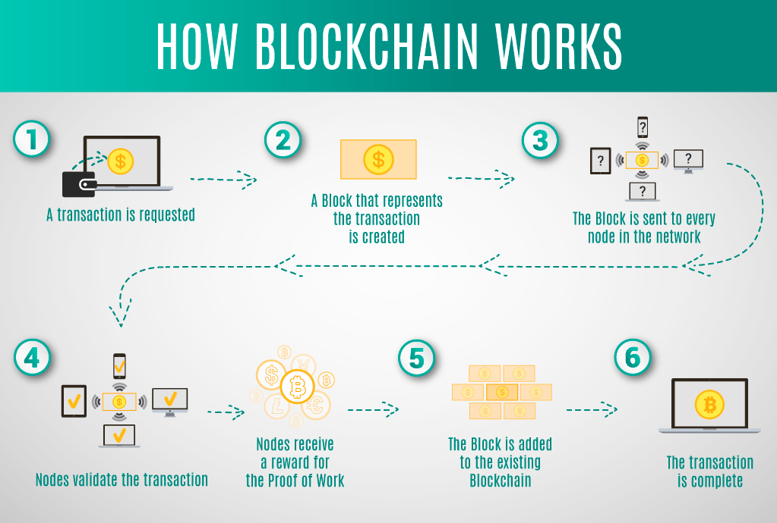
How are blockchains structured?
A blockchain is a linked list or a chain of blocks. Blocks contain all the transaction data and typically contain multiple transactions. Blocks are added to the end of the chain during the mining process. Mining compiles several transactions with info about them into a block and adds them to the end of the blockchain, thus executing them.

Slide 15
Blockchain can best improve voting processes across the world
Blockchain-based voting systems provide full transparency by eliminating the need for central authorities to be involved. Technology can potentially be an answer to the question of how to keep elections and voting as secure and foolproof as possible.
With blockchain, each vote that is counted has to be completely and accurately verified. This means that officials can confirm the voting results as soon as they are finished.

Slide 16
Blockchain – Transformes the traditional ballot system
In comparison with the current system, the blockchain voting system is fair, secure, transparent and offers real-time counting and processing.
User-interfaces in the blockchain voting platform:
Native Mobile application for voters and voting candidates
Web portal for voters, voting candidates and election administrators
Stakeholders involved in the blockchain voting platform:
Voter – Who will vote for the candidate standing in the elections based on their capabilities. The voter must have a smartphone or computer with the front camera. Using the internet connection, the voter can register and vote as well through devices. If the voter doesn’t have a phone or PC, they can visit the polling booths or cyber cafes to vote. Candidate – A person who participates in the elections to represent a specific political party. Using the web portal, the candidate who participates in the election can receive the votes in their blockchain platform account. They can check the number of votes in their account during the election. Election Administrators – Who manage the entire process of the election. The duties that performed during elections are done by the election commission. They observe and verify the votes in the blockchain system and perform the audits at any time. They specify the election type, create, activate and close the elections. Once the elections are conducted, they can post the reviews confirming the validity of the election results.

Slide 17
The Blockchain voting system could have the following steps:
Step1: Candidate’s Registration
Candidate can register on the blockchain enabled platform to receive the votes during elections. For registration, candidates need to submit PII (personally identifiable Information), that would be stored on the public blockchain(1).
The candidate’s information is accessible to every stakeholder involved in the system. The stored details on the blockchain could help voters to know about the candidates and their capabilities before voting.
Once the candidate successfully gets registered on the platform, the private key would be generated, enabling candidates to check the number of votes in their account during elections.

Slide 18
Step2: Voter’s Registration
To register on the platform, a voter would need to submit PIIs and proof of their citizenship. And, all the users’ information stored in the IPFS(3).
The information submitted by the voter would be verified through existing government-approved systems. If the documents are checked and found to be correct, then they are allowed to create their account on the system.
After successfully signing up on the system, the private key would be generated and the public key will be saved on the blockchain after getting verified. Using the private key, the voter can cast vote during elections.
All the information submitted by the voter is encrypted by the private key. Moreover, voters can view the candidate’s profile to check his capabilities before casting a ballot.
With no doubt, the critical aspect of democracy is the secret ballot; thus it is essential to maintain the anonymity of the voter’s vote.

Slide 19
Step 3: Voting on Blockchain
On the election day, participating candidates can receive the votes in their account on the blockchain voting platform.
At the time of elections, every voter needs to login to the platform by using the private key. And, if it’s valid, then voter can cast the vote to their choice of candidate.
The voter can encrypt their vote with the public key and send it to the Arbitration Server(2), ensuring the voter’s anonymity.
Meanwhile, the AR(2) is responsible for sending the voter’s vote in the form of the voting token to the appropriate node. Each node would verify the transactions according to the regulations built in the Smart Contracts.
The Smart Contracts would cross-verifying the votes received with the number of voter’s voted in total against all candidates.
Casting the ballot on the Blockchain involves sending the voting token to the candidate’s account. When the voter logs in the system, they have the limited time period to send the vote to the candidate’s account. If they are unable to send votes in the set time period, the smart contract would destroy the voting tokens.
The vote stored on the blockchain is verifiable, immutable and transparent.

Slide 20
Step 4: Verifying the vote
The verification process of the voting depends on the type of elections. Some elections allow for short-term results and some do not.
If the election allows for the short-term result, then one of the blockchain’s nodes could be made publicly accessible. On the blockchain system, the voter could enter the public key and verify whether their vote was counted.
If the election’s organizers want to keep a secret result, the voter could only get a binary verification via the arbitration server. But, at the end of the election, the voter will be able to verify whether their vote was counted or not for the election.
With blockchain, voters can track their vote and can verify if it ended up in the right candidate’s account. Though voter’s information is not tied to it, the voting history would be saved on the blockchain.

Slide 21
Step 5: Counting the votes
Voting could be transparent with the blockchain system as it makes easy to follow and evaluate votes in the real-time.
Each voter can vote once for the candidate of their choice. And, the candidate who has the highest number of voting tokens in their account wins the election.
For voters who abstained from voting, their voting tokens will be sent to an abstain account, ensuring their vote does not get misused. The counting of the ballots is so easy and can declare the winner of the election in the shortest span of time.
Step 6: Election’s results
Using the blockchain voting platform, the elections’ result is instant. The pre-defined rules built in the smart contracts notify the stakeholders that voting has been closed along with the election results.

Slide 22
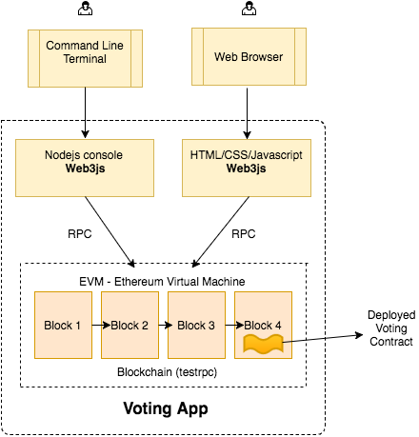

Slide 23
Social advantages of the system
The system would increase convenience for voters who found trouble for moving around to vote.
It is a fast and secure way to vote and can increase the number of voters since the process does not take up too much of their time.
While the system is highly transparent and traceable, it can help to build trust amongst the people towards the government.
The blockchain voting system is environment-friendly as compared to the paper voting system. It eliminates the need for paper voting and reduces the carbon emitted by the logistics of those ballots. Hence, the system has a lower carbon footprint.
Elections are a crucial aspect of democracy. Any government party or electoral committee will do their job very sincerely when it comes to changing the way elections are held. The blockchain voting system not only handles voter privacy and auditability but also offers a transparent and traceable system for verification of the ballots. Moreover, the blockchain platform is cost efficient as compared to the traditional system and can transform the way of voting.

Slide 24
Envisioned essential requirements that need to be fulfilled by an e-voting system in order for it to effectively be used in a national election:
An election system should not enable coerced voting.
An election system should not enable traceability of a vote to a voter identifying credentials.
An election system should ensure and proof to a voter, that the voters vote, was counted, and counted correctly.
An election system should not enable control to a third party to tamper with any vote.
An election system should not enable a single entity control over tallying votes and determining an elections result.
An election system should only allow eligible individuals to vote in an election

Slide 25
Blockchain technology is having its own set of limitations/drawbacks
Some of these are :
Waste of resources : As blockchain is based on the distributed nature of architecture, every node has to run blockchain in order to have consensus among nodes. Though this leads to lot of advantage, but in some way, this repetition of task leads to duplication in computation needs, storage and wastage of important natural resources such as electricity.
Network speed : As computation happens across nodes, the speed slows down and backlog starts building up at nodes in the network.
Speculative power : blockchains such as Ether are run usingtoken/currency models to fund development or manage the economics of Nodes. Blockchain based currencies are trying to position themselves as an alternate to traditional currencies such as USD, GBP, EUR etc. Traditional currencies are strongly backed up by sound economic condition of the home country. Blockchain has no such backing and hence blockchain based currencies are highly speculative in the market.
Human error could lead to huge lost of trust: If a blockchain is used as a database, the information going into the database needs to be of high quality. The data stored on a blockchain is not inherently trustworthy, so events need to be recorded accurately in the first place.
Unavoidable security flaw : There is one notable security flaw in bitcoin and other blockchains: if more than half of the computers working as nodes to service the network tell a lie, the lie will become the truth. This is called a '51% attack'.

Slide 26
DEVELOPMENT OF THE VOTING SYSTEM
Implementation:
Building simple voting system, a decentralized app on a blockchain. This is the approach to implement the complete Election System over the Blockchain serves online and it is completely Distributed and Decentralized
What will this app do?
This will allow to display two possible choices and will allow us to vote for 1of the choices. For example, we will consider two parties i.e. BJP and Congress. We will keep track of who is voting and we won’t allow them to vote again. Each user only gets one vote. At end we will allow the administrator to end the polling and display the results. The administrator will only be able to start the app and end the polling.

Slide 27
How will we do it?
There will be five main steps to do this.
At first, we will write the smart contract. In this we will go to the remix that is free ide that is used to develop the smart contracts. We will write very simple voting system.
Second part will be building the interface and installing dependencies such as truffle and ganache.
The third step will be connecting the smart contract and interface. We will connect smart contract and interface by migrating the smart contract to your Ganache blockchain.
The fourth step will be interacting our browser with sites that access the blockchain by using the browser extension called MetaMask.
Now at last we will connect our browser to the blockchain and display the webpage.

Slide 28
Writing the smart contract using Solidity ide remix (remix.ethereum.org)
What do we need in the smart contract?
Most voting systems have voting and candidate structs.
Voter struct represents the single voter. It will keep track of voter name, who they voted for etc. And
Candidate struct will be the possible candidate for whom the user can vote for. The candidate struct will have name and number of votes they got.
After this we will have mappings and arrays to hold lists of these structs to keep the track of who has voted and who our candidates are.
We will need constructor to start the new instances of the contract and do a little bit of setup. And also, we will few functions to vote, to get the number of votes and display the results of the polling.
Starting the project using Remix on website remix.ethereum.org. We will start a new smart contract name it as ‘simpleVoting.sol’.

Slide 29
After making a smart contract file, we will start to write code.
Use JavaScript VM environment.
We are using the latest version of solidity so we will write the pragma solidity ^0.4.25; Then we should check that the compiler is set. The we will write a contract that is simple voting. And then we will write the constructor which we will keep public.
pragma solidity ^0.4.25;
Then we will write the Contract to allow users to cast votes and declare a winner. It gives chance to voters to vote for the candidate they wish to vote for. This contract also allows to declare the winner of the polling.
contract Simple Voting {

Slide 30
Then we will make a Struct to represent the candidate that people can vote for. The struct will have the name of the candidate and the number of votes that the candidate has received.
struct Candidate
{
bytes32 name;
uint numberOfVotes;
}
Then we will make a Struct to represent the person who can Vote for a particular candidate. This struct tells whether the user has voted or not. It also tells the index of the candidate for whom the user has voted for.
struct Voter
{
bool voted;
uint vote;
}

Slide 31
Then we will make a list. This list will include all the candidates to whom user can vote. The user will choose the candidate to vote from this list.
Candidate[] public candidates;
Then we will make another list. This contains list of users who have voted. This list voters is sorted by their address.
mapping(address=> Voter) public votes;
Then we will write the address for the admin. This administration controls the voting system. For example, we will consider chairperson as an admin.
address chairPerson;

Slide 32
Then we will write a constructor to create a new voting system. This constructor will be of public type.
constructor() public{
chairPerson = msg.sender;
candidates.push(Candidate({
name: 'BJP',
numberOfVotes: 0
}));
candidates.push(Candidate({
name: 'Congress',
numberOfVotes: 0
}));
}

Slide 33
Then we will write the function to cast a vote.
This function takes in the candidate to cast a vote for.
function castVote(uint candidateIndex) public {
address sender= msg.sender;
require(!votes[sender].voted,'Voter has already voted');
candidates[candidateIndex].numberOfVotes += 1;
votes[sender].voted = true;
votes[sender].vote= candidateIndex;
}

Slide 34
Then we will write a function to get the number of votes that a candidate has received. This function takes in the index of the candidate and returns the number of votes they have received.
function getNumberOfVotes(uint candidateIndex)public view returns (uint)
{
return candidates[candidateIndex].numberOfVotes;
}
This is the last function we will write to get the winner. This function tells who is current in the lead. It returns the name of the candidates with most votes.
function getWinner() public view returns (bytes32 winner)
{
uint maxNumberOfVotes;
uint length=candidates.length;
for( uint i=0; i<length; i++){
if(candidates[i].numberOfVotes > maxNumberOfVotes)
{
winner = candidates[i].name;
}
}

Slide 35
Build the interface and installing dependencies such as truffle and ganache
We will install dependencies such as truffle and ganache. Then we will create a new project directory and navigate to it from our terminal. My DApp is called DigiVote-master.
mkdir DigiVote-master
cd DigiVote-master

Slide 36
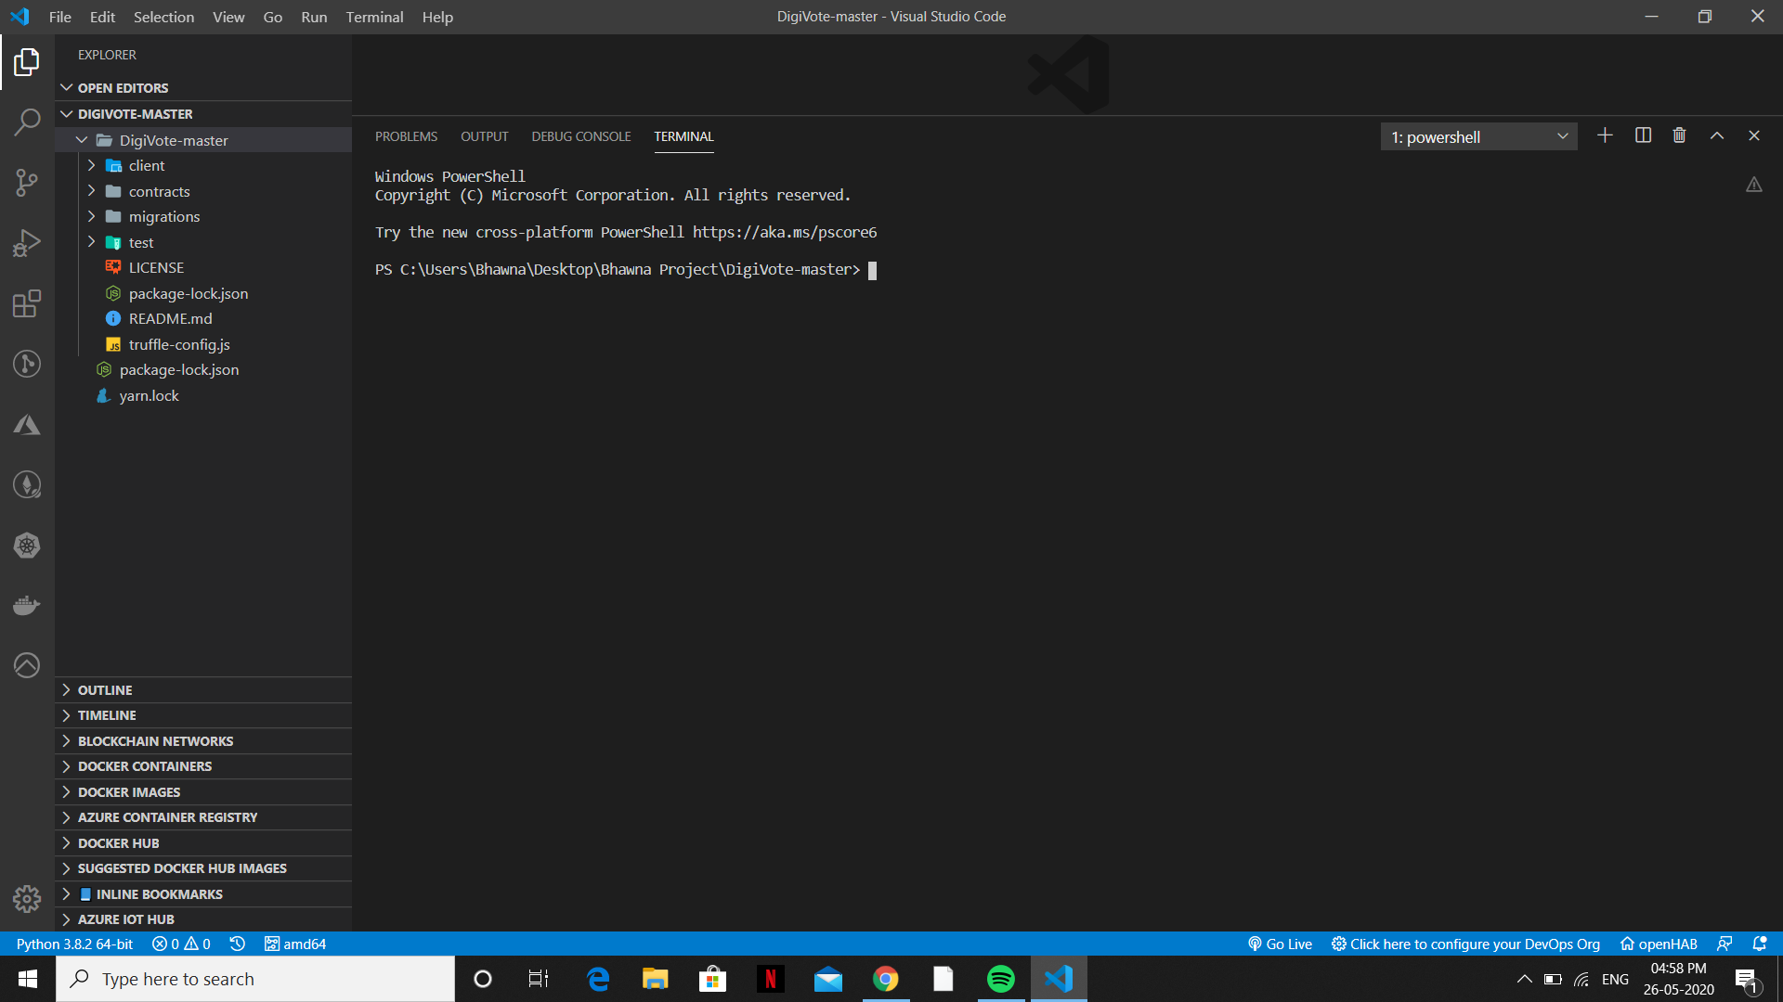
Truffle Box:
We use Truffle Suite to create our DApp. It is a popular framework for developing full-stack decentralized applications on the Ethereum network.
Truffle provides projects called Boxes that are pre-configured to let us focus on functionality rather than fiddling with configuration. We will use React Box which comes with a React front end ready built.
truffle unbox react
This may take time but once completed we will see folder structure like this in our text editor.
Figure 1 : Folder structure

Slide 37
client/ contains our front-end React code. We need to delve into this to make changed to our webpage once our contracts have been deployed.
contract/ is where our Solidity smart contract is stored. We will notice that there are three smart contracts. Migration.sol is used during the migration process.
migrations/ is where migration logic resides.
test/ is where we test our smart contract to ensure it functions as expected.
truffle-config.js -It contains information about networks, compilers, file locations, and other custom configurations for the Truffle framework to know where our things are.

Slide 38
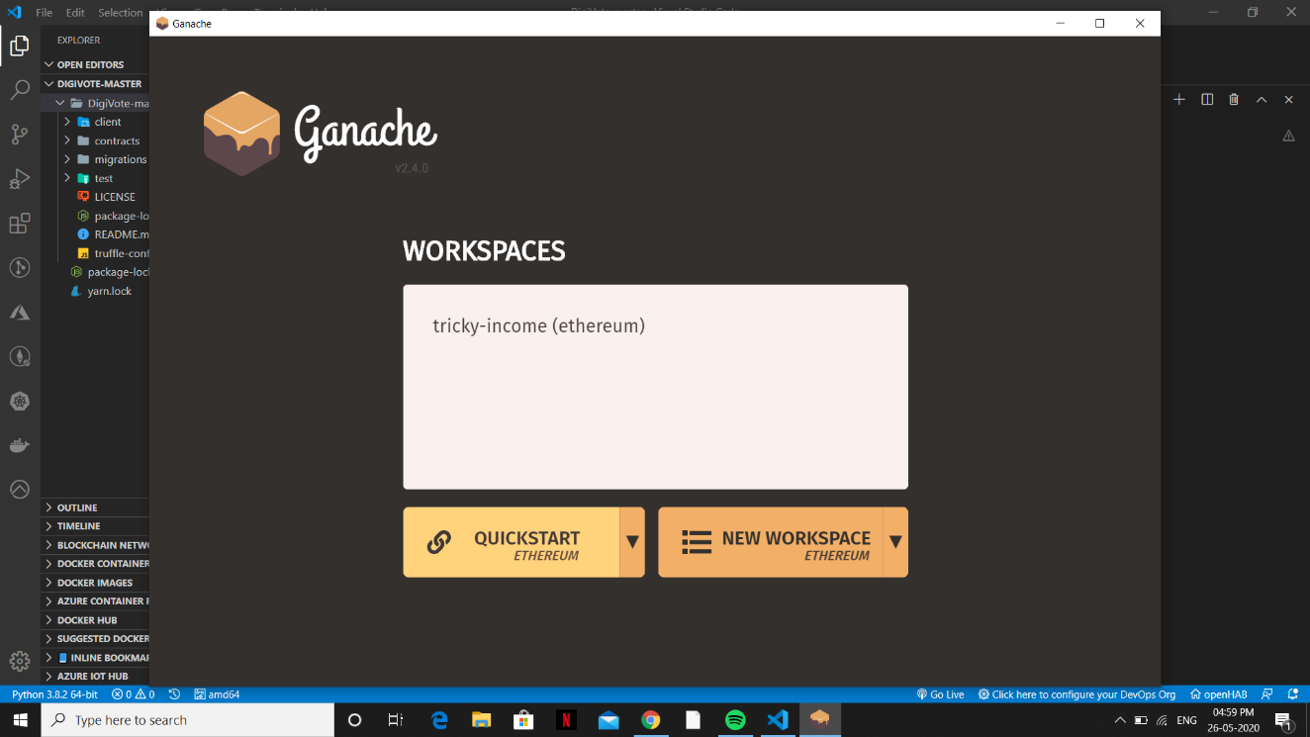
Migrating:
We will use Ganache Tool to create workspace.
We have to now open Ganache, our local blockchain and make a note of the Network ID and RPC Server information.
Figure 2: Ganache Tool

Slide 39
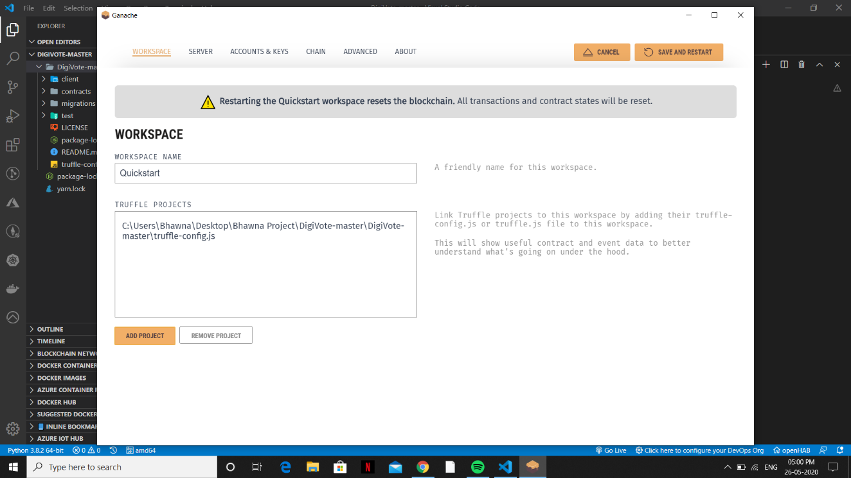
We will copy this info into our truffle.config.js file in the project root directory. Make sure our network name is development and not develop.
Figure 3: Adding Truffle Config file to create Workspace

Slide 40
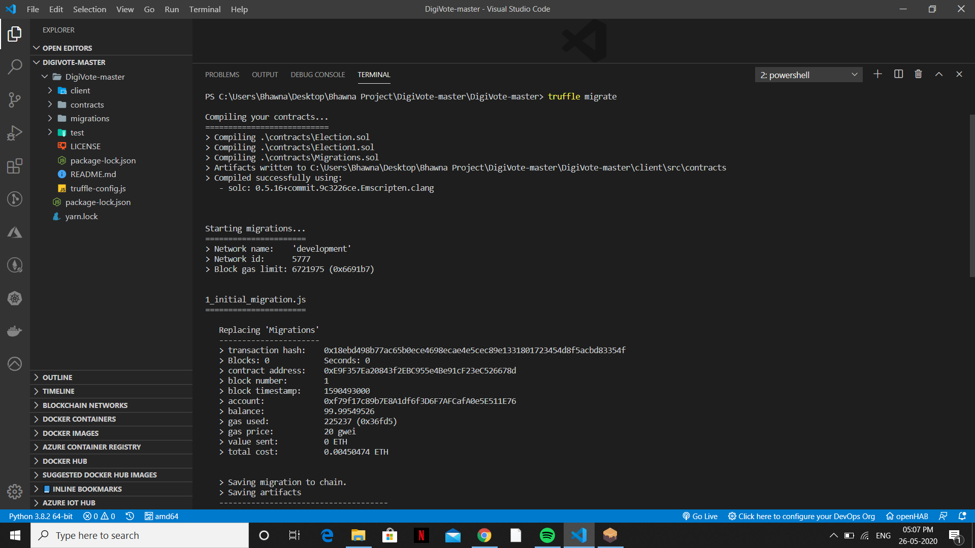
truffle migrate
Now run the following code in your terminal to migrate the smart contract to your Ganache blockchain.
Figure 4: Output in the terminal during deploying of the contracts

Slide 41
React Client:
Before doing any React coding, we need to make sure that our browser can interact with sites that access the blockchain. We do this by using the browser extension called MetaMask.

Slide 42
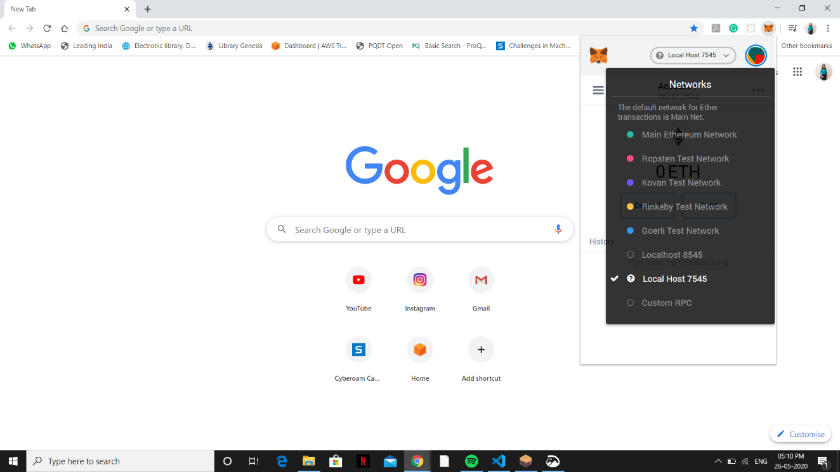
MetaMask:
MetaMask is a browser plugin that allows us to make Ethereum transactions through regular websites. We have to install this extension and create the account.
Figure 6: Adding Localhost network to the MetaMask extension

Slide 43
Next, we click on the MetaMask icon in our browser and log in. There, we need to add a custom RPC so the extension can access your local blockchain. Use the information from Ganache, head back to MetaMask, click Custom RPC, and enter the information. We see it appear in the list of connections with http://localhost:7545. Connect to this network by clicking it.
MetaMask creates a wallet address when you create an account, but you can also import other wallet addresses provided you have control of the private keys. This is great for testing because we can use the accounts provided by Ganache to interact with our local blockchain.
Head over to Ganache and copy the private key from the first address in the list. You can display the private key by clicking the key icon on the right side of the row for each account, as shown in Figure.

Slide 44
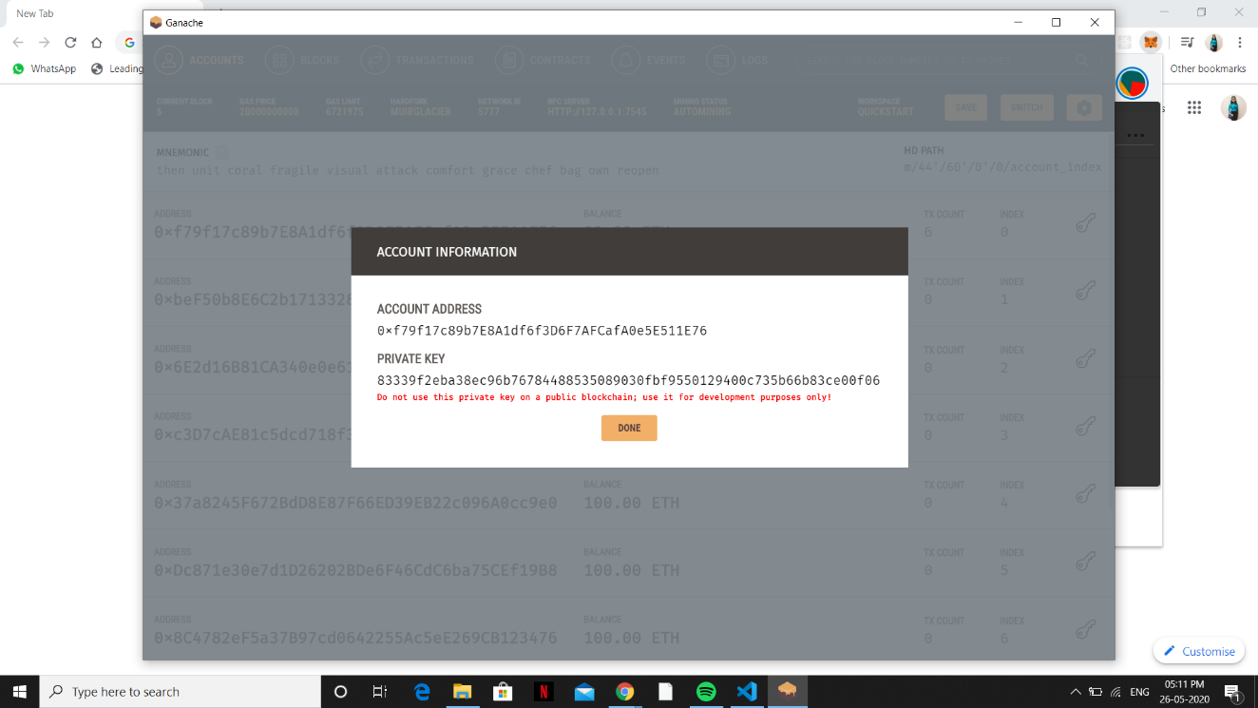
Figure 7: Capturing Private Key from Accounts Tab in Ganache Tool

Slide 45
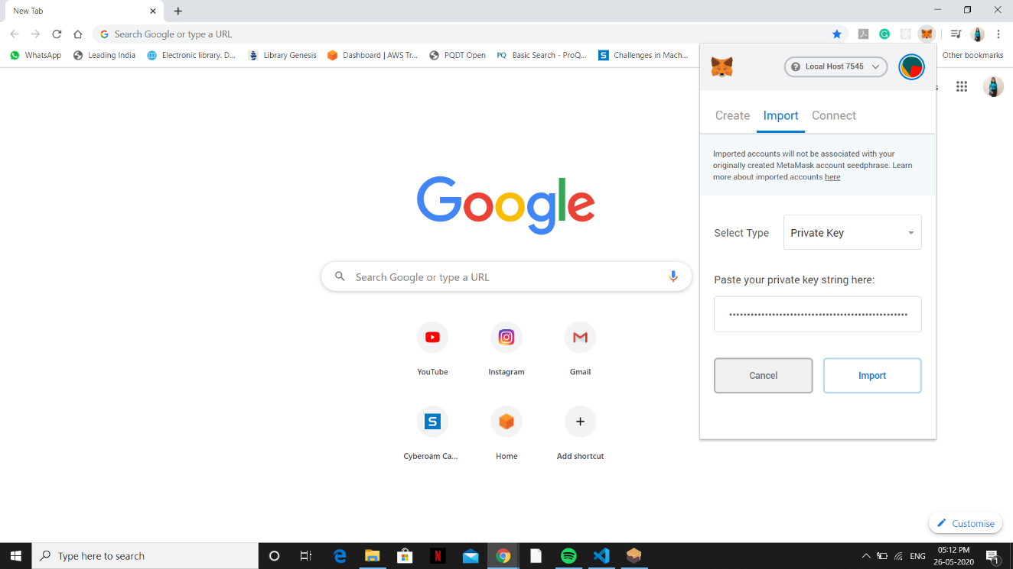
Head back to MetaMask in your browser and open the Accounts panel by clicking on the icon in the top-right corner. Click Import Account, paste the private key in, and click Import. This will add the account to your list of accounts. Select that account. Great! Let’s test it out.
Figure 8: Pasting private key string over the MetaMask for connectivity.

Slide 46
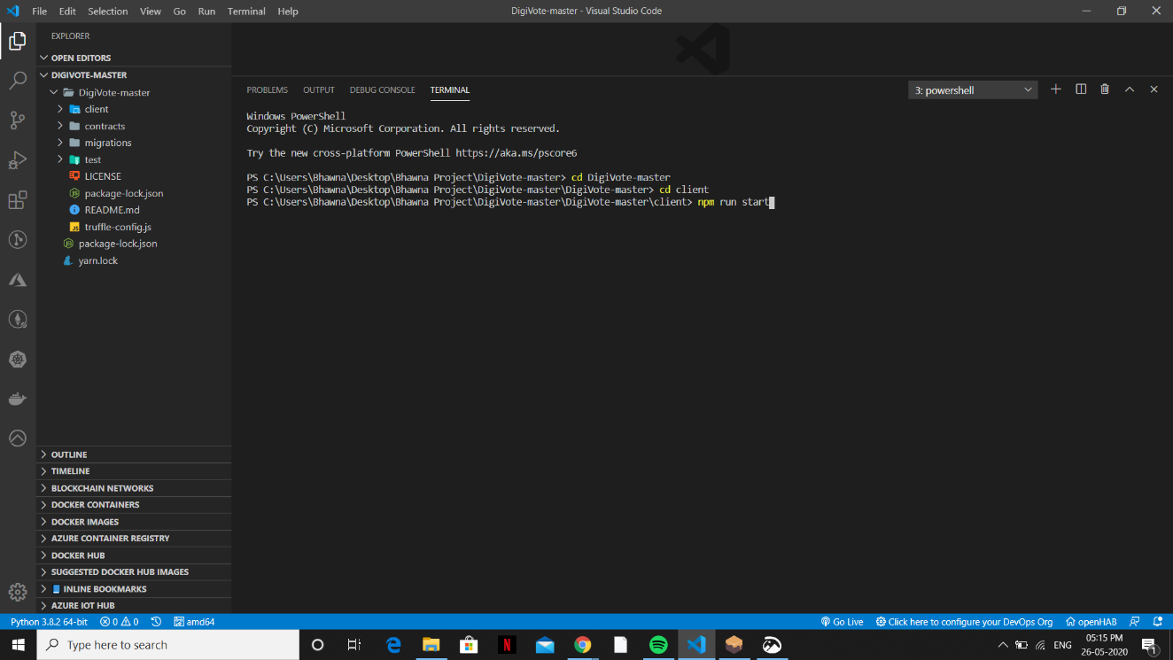
Front end
Let’s test our React client. As I mentioned earlier, the Truffle Box provides some React boilerplate. In your terminal, navigate into the client/ folder and run the following:
npm run start
Figure 9 Executing React application through this command

Slide 47
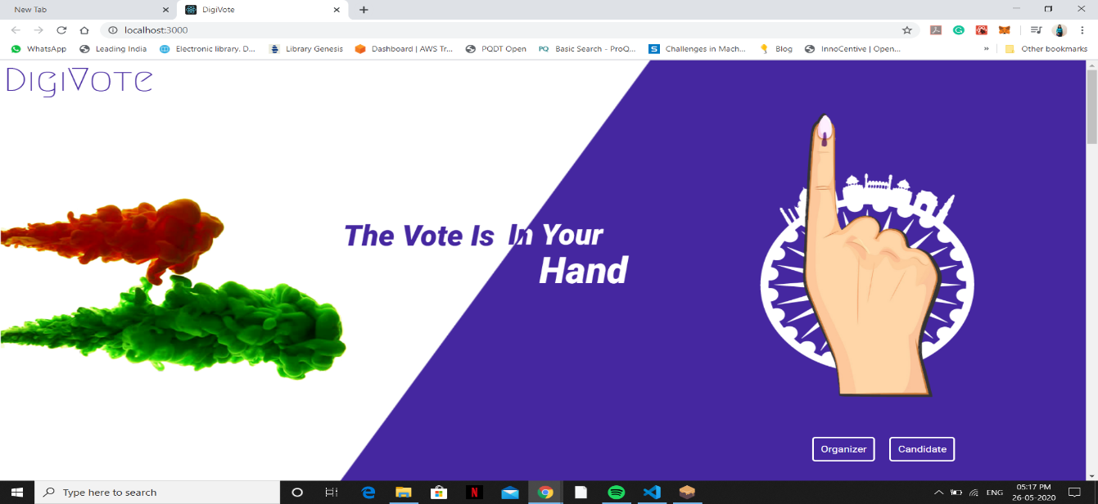
This should open a new browser tab and attempt to connect your browser to the blockchain. You’ll get a notification from the MetaMask extension attempting to connect. Confirm it. This webpage is displayed:
Figure 10 Main Page of DIGIVOTE after execution

Slide 48
RESULTS AND ANALYSIS
Exploring the Voting phase
Organizer & Candidate Registration
Election Creation
Nomination of Candidate for Election.
Voting by Voter.

Slide 49
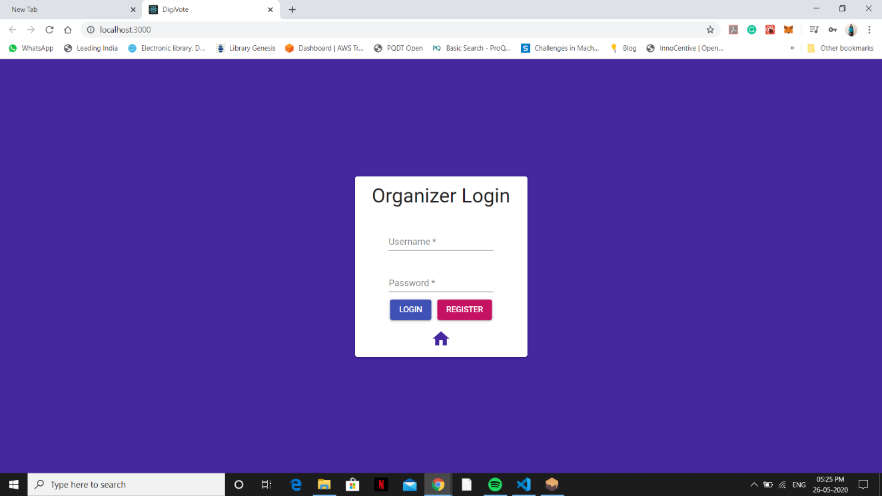
Outputs:
1. Organizer and Candidate Registration
Now on the webpage click on Organizer and register.
Figure 11: Organizer Login Page

Slide 50
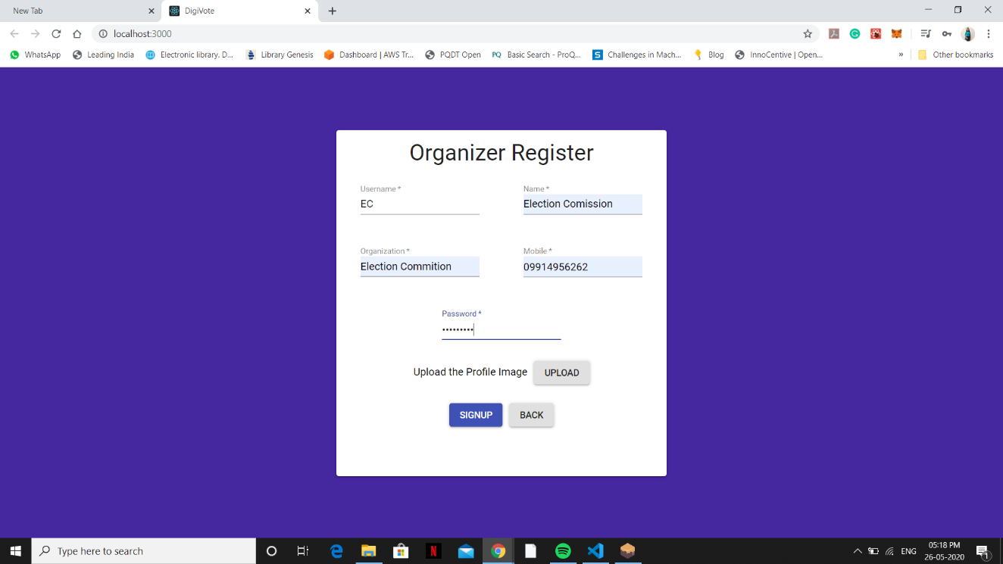
Figure 12: Organizer Registration Page

Slide 51

Now click on Home option and then click on Candidate. Now register Candidate.
Figure 13 :Candidate Login Page

Slide 52
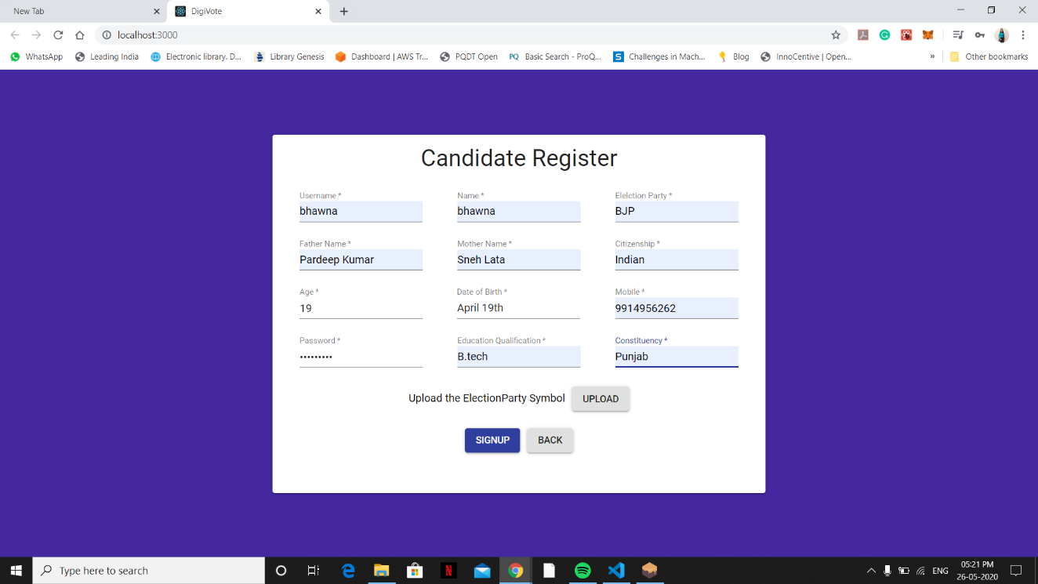
Figure 14: Candidate Registration Page

Slide 53
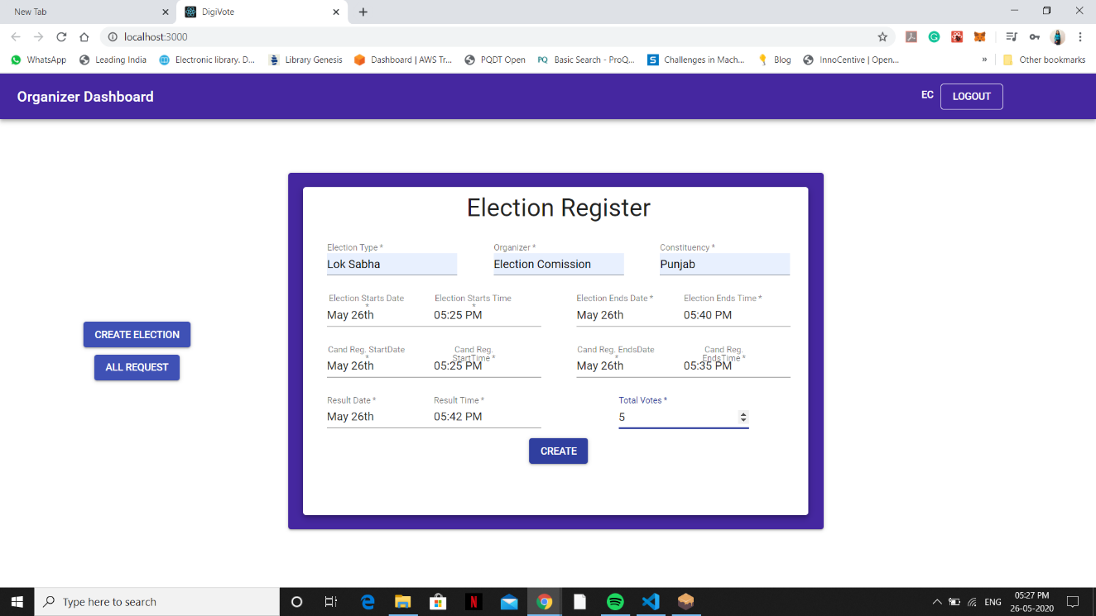
2.Election Creation
Now we create Election. We go to Organizer on homepage and login as registered organizer. Then we click on create election.
Figure 15: Election Registration Page

Slide 54
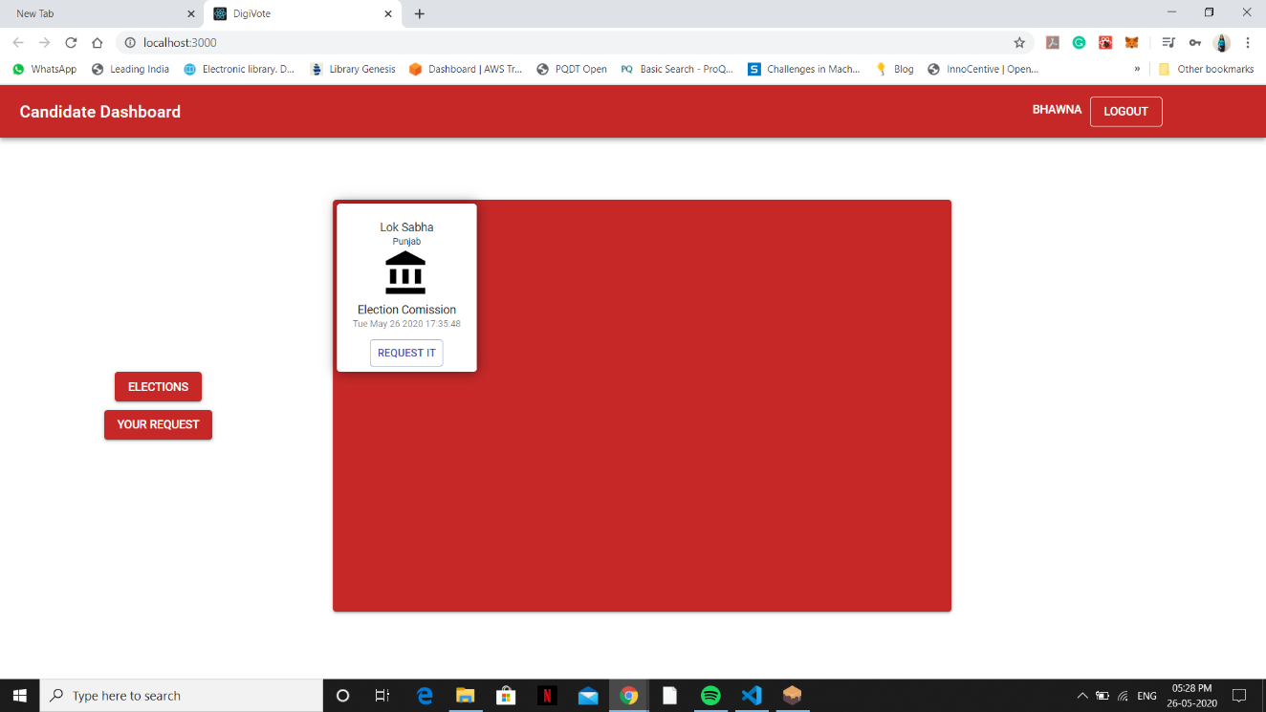
3.Nomination of Candidate for Election
Now we nominate the registered candidates for election. We click on Candidate option on the homepage after logging out of organizer and login as registered candidate.
Figure 16: Candidate Dashboard

Slide 55
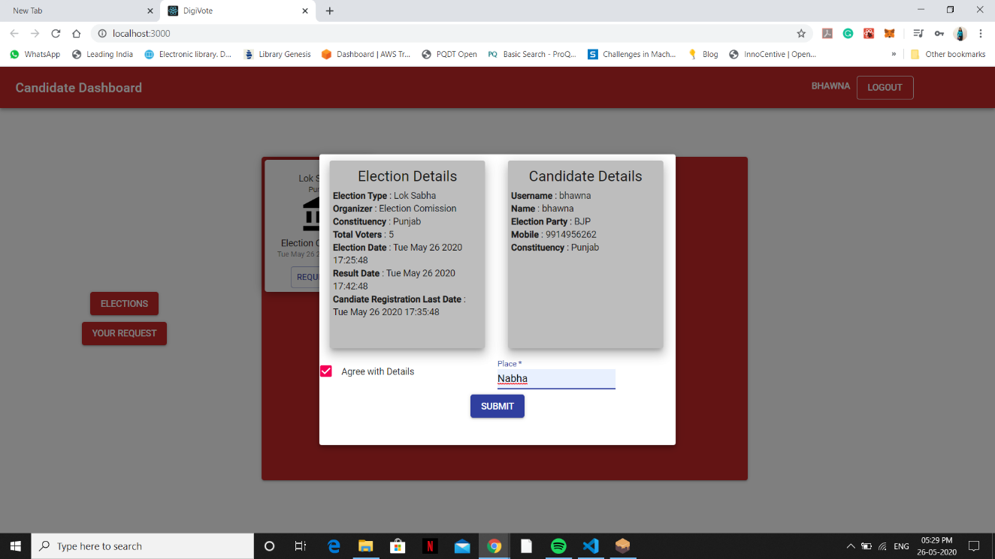
Figure 17: Candidate Request

Slide 56
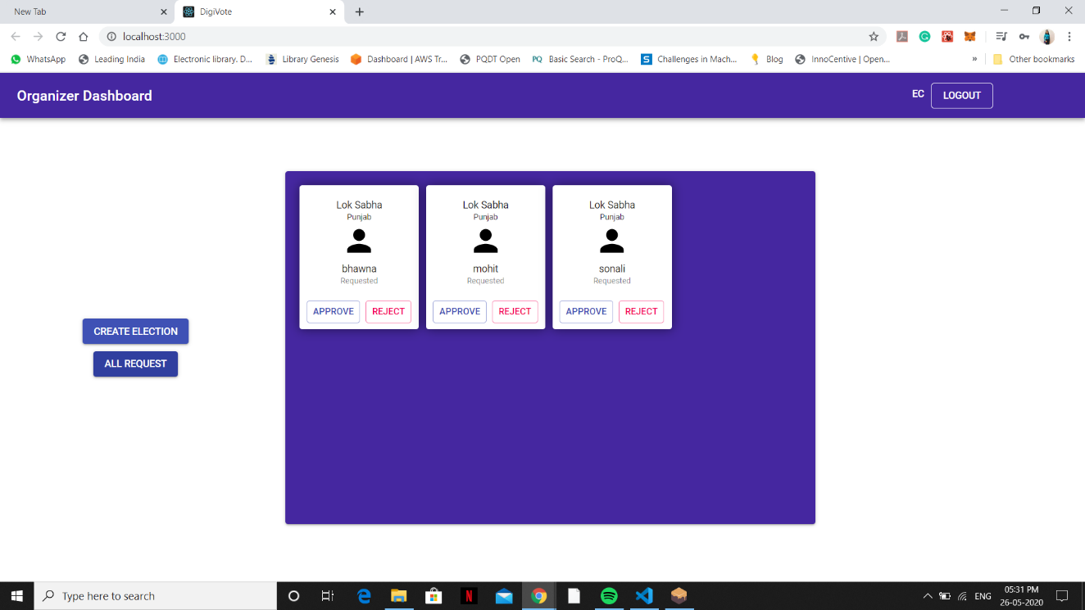
After nominating candidate. Approve the nomination of candidate by going to organizer all requests.
Figure 18: Organization Approval Dashboard

Slide 57
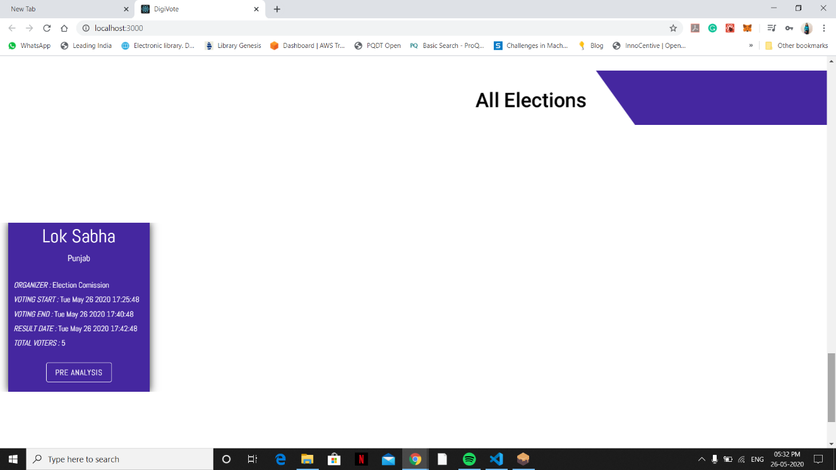
4.Voting by Voter
Now voting will take place. Click on vote by clicking on reanalysis election option on homepage.
Figure 19: Live Elections

Slide 58
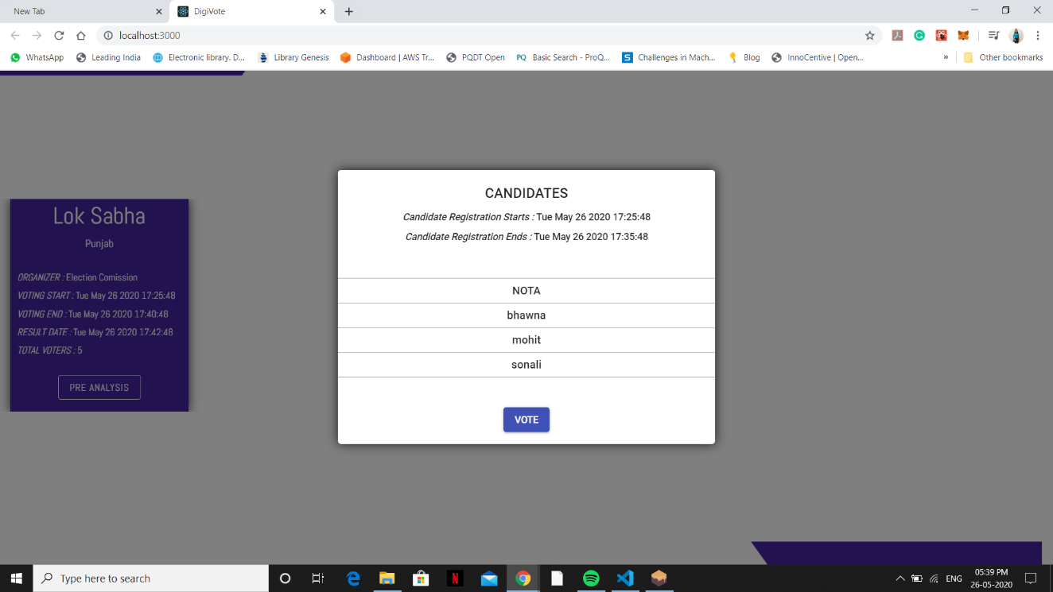
Figure 20: Vote candidates

Slide 59
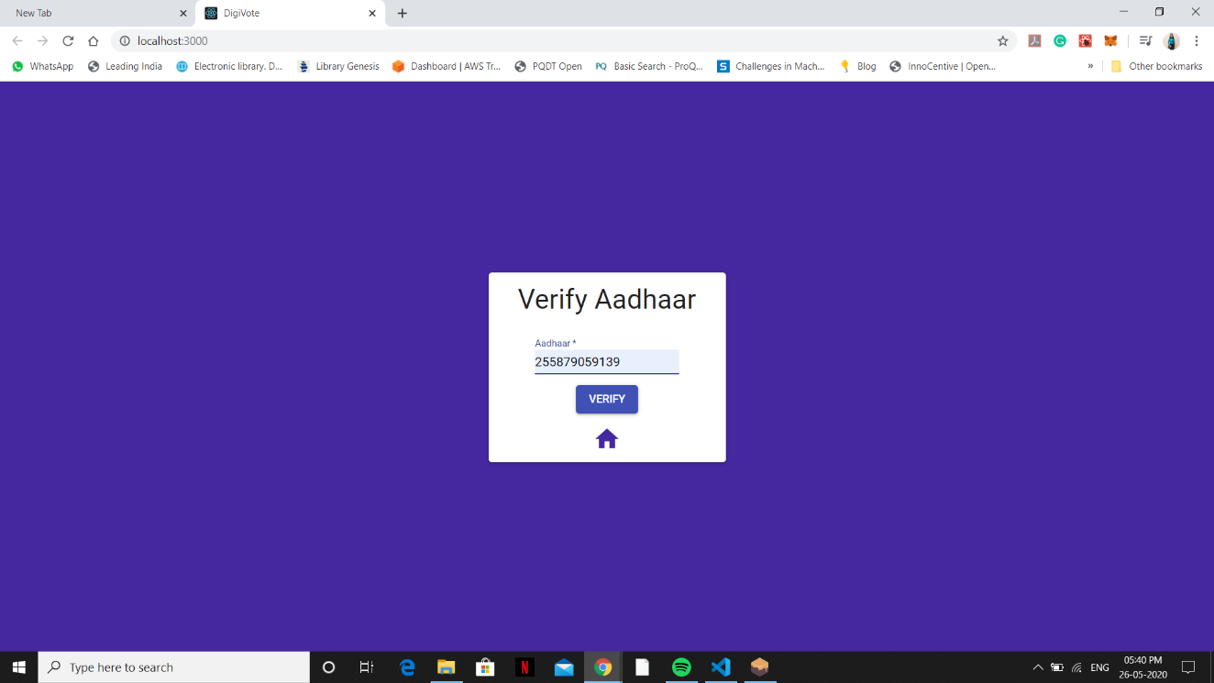
Figure21: Aadhaar Card Verification

Slide 60
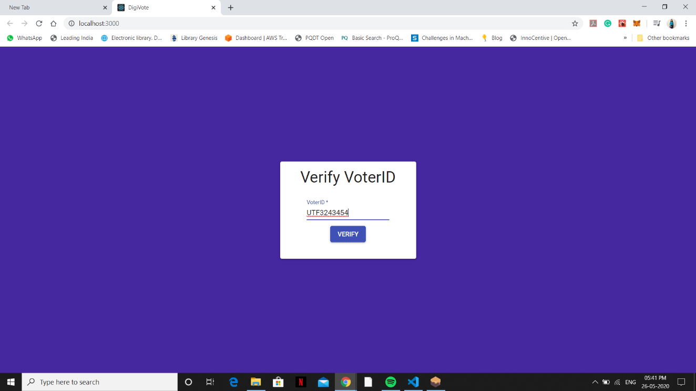
Figure 22: Voter Card Verification

Slide 61
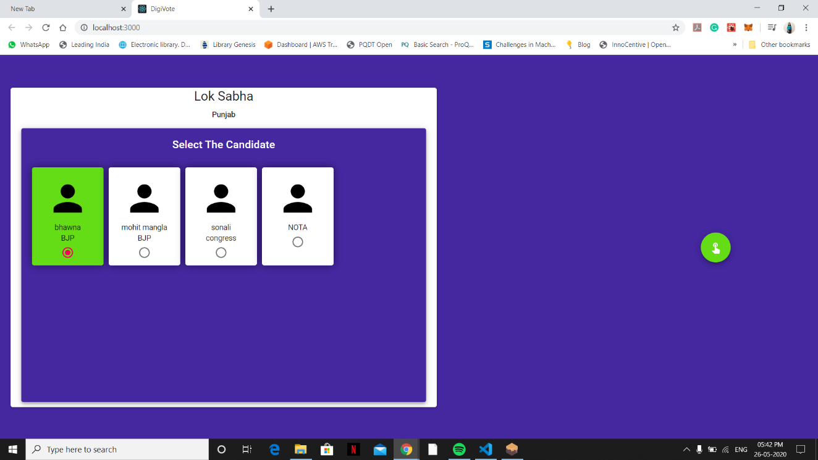
Figure 23: Lok Sabha Vote for Candidate

Slide 62
SECURITY ANALYSIS AND LEGAL ISSUES
In this section we analyse the security of the proposed Electoral Voting System and the main legal issues.
A. Security analysis
1) DDoS: To successfully DDos a distributed system such as we have proposed, the attacker must DDoS every single boot node in the private network. The individual or institution would be immediately located if that would occur. Each node is implemented with a Byzantine fault tolerance algorithm, which helps locating failed nodes in the system.
2) Authentication vulnerability: Each individual is identified and authenticated by the system by presenting an electronic ID from Auðkenni and the corresponding 6-digit PIN in the voting booth. Without supervision, an individual could vote for multiple people, if the individual had knowledge of the PIN for each corresponding electronic ID he has. To further address this vulnerability in the near future, a biometric scan could be introduced.
3) Sybil: Sybil attack is known against centralized systems, where an individual creates a large number of nodes in an attempt to disrupt network operation by hijacking or dropping messages. Since our proposal is running in a private network no individual has the access to create one. Even the consensus protocol that is used in our system is prone Sybil attacks. Private blockchains solve many of today’s security problems using strong cryptography features and the limited access to the ledger, without negating the transparency aspect the blockchain technology offers.

Slide 63
B. Legal issues
1) Remote voting: Remote elections provide no coercion resistance because of the non-supervised factor in a remote election. Remote elections can therefore not guarantee the privacy that people have when they cast their vote in a voting booth. Family members or a coercer can watch over your shoulder while you’re voting, which could lead to a misconfigured result. If elections are hosted on a website for example it could easily be taken down by people with good hacking skills and the mindset to do so. People could identify themselves as another person and therefore vote for another person and even multiple people.
2) Transparency: In the today’s election scheme, no method of transparency can be offered to participants of the election. When an individual place his ballot in the box at his voting district, there is no guarantee from the scheme that his vote was counted and counted correctly. Any individual vote can be misplaced, counted incorrectly because of human error or simply because the party which the voter voted for could be disliked by the individual which counted the vote. This transparency is non-existent because no ballot has information on who casted aforementioned vote. To introduce transparency in the process of an election would require a new law which would allow government officials to provide the services which allow such method of transparency
3) Voter privacy: In every pen and paper election scheme, voter’s privacy is a key element. The law forbids any individual or entity to be able to know from a single vote, who gave aforementioned vote. If such information could be gathered for each vote, such information could then leak to the public which would allow for listing every single individual who voted for a single party/candidate. To satisfy the privacy of each voter, no individual vote should be traceable back to the voter.

Slide 64
Tools Used
Language- HTML, CSS, JavaScript, Solidity
Technique Used-
1. Ethereum Blockchain
2.ReactJS
3. Web3JS
4. IPFS : for decentralize data storage.

Slide 65
CONCLUSION
The idea of adapting digital voting systems to make the public electoral process cheaper, faster and easier, is a compelling one in modern society. Making the electoral process cheap and quick, normalizes it in the eyes of the voters, removes a certain power barrier between the voter and the elected official and puts a certain amount of pressure on the elected official. It also opens the door for a more direct form of democracy, allowing voters to express their will on individual bills and propositions.
In this report, we introduced a unique, blockchain-based electronic voting system that utilizes smart contracts to enable secure and cost-efficient election while guaranteeing voters privacy. We have outlined the systems architecture, the design, and a security analysis of the system. By comparison to previous work, we have shown that the blockchain technology offers a new possibility for democratic countries to advance from the pen and paper election scheme, to a more cost- and time-efficient election scheme, while increasing the security measures of the todays scheme and offer new possibilities of transparency.
Using an Ethereum private blockchain, it is possible to send hundreds of transactions per second onto the blockchain, utilizing every aspect of the smart contract to ease the load on the blockchain.
This online voting system is managing the generation of result of an electoral process held among specific number of parties(candidates). Voter has the right to contribute its vote and check the election result.

Slide 66
References
1. Friðrik Þ. Hjálmarsson, Gunnlaugur K. Hreiðarsson “BLOCKCHAIN-BASEDE-VOTING SYSTEM “ School of Computer Science Reykjavik University, Iceland.
2. Emre Yavuz, Ali Kaan Koç, Umut Can Çabuk, Gökhan Dalkılıç “TOWARDS SECURE E-VOTING USING ETHEREUM BLOCKCHAIN “: 2018 6th International Symposium on Digital Forensic and Security (ISDFS), IEEE.
3. Teogenes Moura, Alexandre Gomes BLOCKCHAIN VOTING AND ITS EFFECTS ON ELECTION TRANSPARENCY” Proceedings of the 18th Annual International Conference on Digital Government Research.
4. Ahmed Ben Ayed “A CONCEPTUAL SECURE BLOCKCHAIN-BASED ELECTRONIC VOTING SYSTEM “ School of Computer Science Reykjavik University, Iceland.

Slide 67
THANK YOU

